Slide 1
COMP 1012: Lecture 3 Notes Strings, Files and Loops
St. Lawrence College, Cornwall Campus, Winter 2022
Scott C. Stoness

Slide 2
Strings and Files
Strings and Files are both a collection of characters
Files are on disc
Strings are in memory
Level of abstraction for both Strings and Files
Different depending on the language
Quite high-level for C#
Strings are objects
Files can be opened by filename and read in a single statement
Very low-level for C
A String is a reference to a memory location, terminated by the null character
Files are read one character at a time

Slide 3
What is a Character?
Files and Strings are both collections of characters
So what is a character then?
A letter?
But there are numbers and punctuation
OK, all the numbers and letters and punctuation then.
But in what language?
Fine, include all the languages
What about the end of a line? Or telling the printer to move to a new line? Or a bell?
Why do we need a character that will wring a bell?
I don’t know. But there is one. Typewriters?
Are we good then?
Are emojis characters?
Arrgggh!!!
A bit of computer history is in order

Slide 4
Computer Storage
Computers are based on transistors (originally vacuum tubes)
They can be on or off
So at its heart, everything is a 1 or a 0
A bit is a single on/off value in memory or on disc
Perfect for storing a Boolean variable
A ‘byte’ is eight of them. Why eight?
Binary and history – 8-bits were a common size, and it is a power of 2
A ‘word’ is how much memory a computer reads at once
Hence 32-bit and 64-bit Operating systems
A ‘byte’ is big enough to hold a character

Slide 5
Computer Storage (2)
Why do we care?
Memory – how much space does a variable take?
Boolean – could be one bit
Character – one byte (historically, 2 bytes in C#)
Int – 4 bytes (-2,147,483,658 to 2,147,483,657)
Long – 8 bytes up to 9,223,372,036,854,775,807
Float – 4 bytes (6-7 digits)
Double – 8 bytes (15 digits)
Use to *really* matter
MS-DOS had 640 kilobytes of memory
My computer now has 32GB; servers often have 256 GB of RAM
Modern photos / songs are typically several MB

Slide 6
Character Encoding
ASCII
Originally 7 bits for characters and 1 bit for error checking
Eventually 8 bits for characters
Original 7-bit English encoding used the first 128 characters
Only 128 characters left for every other language in the world
Character Encoding specified what the other 128 characters meant
Western European, Cyrillic, etc.
Not nearly enough
Unicode
A system for representing all the different characters in the world (even emojis!)
Still requires encodings
UTF-8, UTF-16, and UTF-32
Basically the efficiency of the character encoding
Characters ‘seem’ simple, but they aren’t
Without knowing the encoding, we don’t know what a string / file really represents

Slide 7
What about Strings and Files?
As mentioned, strings and text files are just collections of characters
So can I read an entire file into a string?
In C#, yes, easily:
String filecontents = File.ReadAllText(“../../Input/myfile.txt”)
But then what?
Treating files and strings as a monolithic block isn’t very useful.
How do we read a file in a more useful manner?
For lots of files, *lines* are an important concept
E.g. a .csv file of data
For binary files, the *byte* is likely the most important
If we are reading c# code, for example, the *symbol* is the core notion
E.g. a parser, syntax highlighter, IDE
Note: you can also *write* C# code in C# if you want
(how do you think the form designer works) ?

Slide 8
Reading files line by line
If we want to read a file line-by-line, how do we do that?
C# makes it easy with the File class
Note: there is a more basic class called StreamReader that can read multiple types of streams of data (e.g. network socket, file, continuous user input, etc)
File is built on top of StreamReader
You can get all the lines of a file into a collection of strings a couple of ways
File.ReadLines(“../../Input/myfile.txt”)
File.ReadAllLines(“../../Input/myfile.txt”)
OK, why are there two?

Slide 9
File.ReadLines vs. File.ReadAllLines
ReadAllLines reads the entire file at once into a collection, and *then* you can do something.
E.g. In English class, they tell you to read the entire book. You read the entire book.
ReadLines reads the file line-by-line into a collection, and it reads the next line only when something asks it for it.
E.g. In English class, they tell you to read Chapter 1 for discussion tomorrow. You *could* read the entire book. You read chapter 1.
Since generally what we are going to do next is process each line, these are often effectively similar unless
You react to each line as it is read somehow
You have a large file and there is a noticeable delay to read the entire thing
Large is relative these days with modern memory, disk speed, etc. A book is a *small* file.
You have such a large file or you are doing so much with each line that you run into memory issues
You might stop processing part way through the file depending on the input
Conceptually, some similarities with procedural vs. event-driven programming

Slide 10
How do we do something with each line?
Technically, both functions read lines into an Array of strings
For our purposes, all that really matters is that it creates a ‘Collection’
What is a collection?
Something that you can ‘iterate’ through
That is, a bunch of things that you can grab in some order
How do we grab them?
foreach (var line in File.ReadLines("../../Input/" + filename)) {
// do something
}

Slide 11
Foreach loop
foreach (thing in collection) { // do something with thing }
Each time through the loop, ‘thing’ represents the next thing in the collection
First time in loop, ‘thing’ is the first thing
Second time in loop, ‘thing’ is the second thing
It keeps going until it runs out of things or you stop it.
Break; will exit a loop early and stop if you need to
For example, a string is a collection of characters
What if we wanted to build our own version of String.replace?

Slide 12
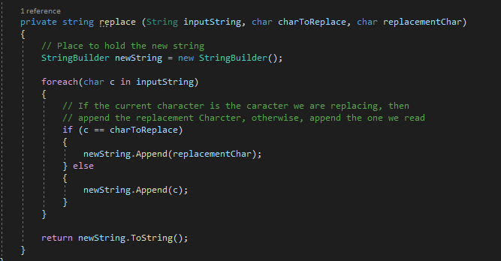
String.replace as a foreach loop

Slide 13
Other loops
While(condition) { // do stuff }
Repeats until condition is false
Do { // stuff } while (condition);
Does stuff, then checks the condition, stops when condition is false.
While(true) { // do stuff }
Loops forever
Jump statements
Break; -- stops the loop, continues below
Continue; stops this iteration of the loop, starts next iteration

Slide 14
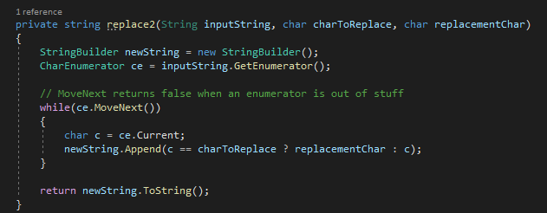
String.Replace as a while loop
This is actually kind of how foreach is built in C#
Technically the foreach uses the Enumerator built into any collection

Slide 15
Collections in C#
Array
We’ll get into these more next week, the fundamental collection
Can be multi-dimensional, which is where they get *fun*
List
Simple list of objects
Dictionary
Simple list of Key-Value pairs
Queue
A collection where you add things to the back and take them off the front
Like a line at the bank, or as the British would say, a ‘queue’
Stack
A collection where you add things to the top and take them off the top
Like a pile of books on the floor, or, you know, a ‘stack’ of pancakes

Slide 16
Collections are flexible and powerful
Certain collections can be sorted
Collections are strongly typed
All objects in a collection are of the same type
Most collections can be traversed (e.g. in a foreach loop)
Some collections allow random access
E.g. look up a Key in a dictionary
What is the 7th character of a String
LINQ (Language Integrated Query) can filter or transform a collection
Declarative way (database query –like) to get a new collection

Slide 17
Strings in C#
A String is an Object (like everything in C#)
It is also a collection of characters
Can be treated almost like an array of characters
But has a *lot* more built-in functionality than an array of characters
Strings are immutable
Once you create a String, you can’t change it
If you concatenate two strings, for example, you get a new String that is different from the first two

Slide 18
So many String methods/properties!
String.Length
Returns the number of characters in the string
String[n]
Returns the character at position ‘n’ of the string (Weird note: 1st position is 0)
String.concat(String A, String B) OR A+B
Gives a new string constructed from the characters of A and B in order
String.StartsWith, String.EndsWith, String.Contains
Returns a Boolean if the string starts with, ends with, or contains a string
String.toUpper, String.toLower
Normalizes the case of the string
String.Trim, String.TrimEnd, String.TrimStart
Gets rid of certain characters at the start or end of the string (or both)

Slide 19
So many String methods/properties!
String.Split
Breaks a string into an array of smaller strings
String.Join
Joins an array of strings together into a single string
String.IndexOf, String.LastIndexOf
Find a character or a string inside a string
String.Substring, String.Remove, String.Insert
Can insert a string at a certain spot, get a substring from one character position to another, or remove a segment of a string
String.Replace
Can replace a character or a string with another wherever it occurs in the string
String.Format
A way to create a string that inserts variables / objects into a string

